Slide 1
National Basketball Association:
Salary v. Player Performance
Rice Data Analytics Boot Camp
Spring 2020
TTh Group 6
Antonia Adeleke
Brent Garbe
Jason Johnson
Notes:
Antonia

Slide 2
Motivation
Results in brief:
We WERE able to answer these questions to satisfaction.
We found that there is a significant statistical relationship between average points per game and salary but not with other key metrics.
Given the complex dynamics of team sports, numerical individual performance may not reveal all aspects of higher paid players value.
Do higher paid players in the NBA perform better than lower paid players?
How are the range of salaries in the NBA distributed?
Is there an association with player salary and major metrics of performance?
Are there any skills that money does not help
Notes:
Antonia -

Slide 3
Questions & Data
Our basic questions and the data we sought:
Do higher paid players in the NBA perform better than lower paid players?
We need data on player salaries and performance metrics.
How are the range of salaries in the NBA distributed?
If we can get salary data on a representative # of players, we should find representative results of the entire population.
Is this a normal distribution? Or is a there a regression to the mean with a small number of outliers?
Do higher paid players play more or less minutes?
Do higher performing players play more or less?
Notes:
Antonia

Slide 4

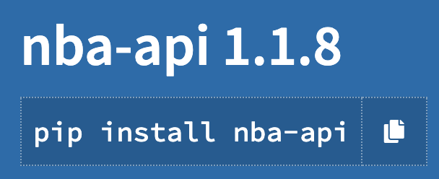


Data Cleanup & Exploration
We were able to identify data from four sources including two sites using pd.read_html and from two API sources.
Much of the data (but not all) was redundant.
One issue we had to deal with was a massive overabundance of data -- partially due to aggressive data gathering which then led to potentially greater cleaning efforts.

Slide 5
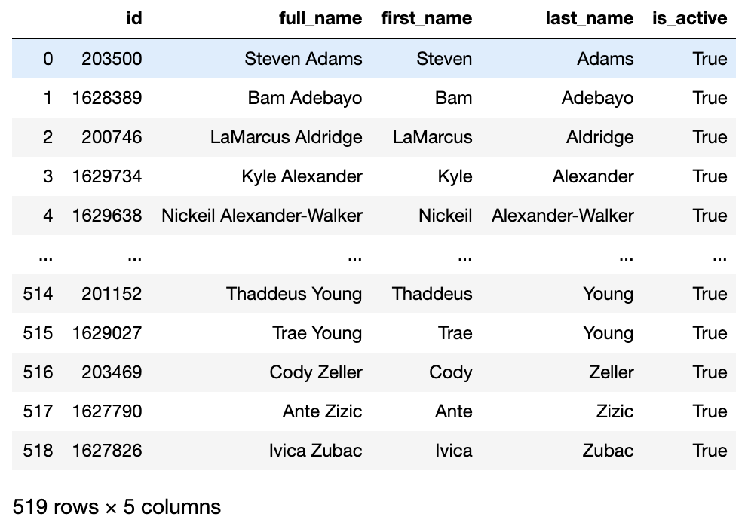
Data Gathering
PLAYER_ID
SEASON_ID
LEAGUE_ID
TEAM_ID
TEAM_ABBREVIATION
PLAYER_AGE
GP
GS
MIN
FGM
FGA
FG_PCT
FG3M
FG3A
FG3_PCT
FTM
FTA
FT_PCT
OREB
DREB
REB
AST
STL
BLK
TOV
PF
PTS
Notes:
Jason

Slide 6
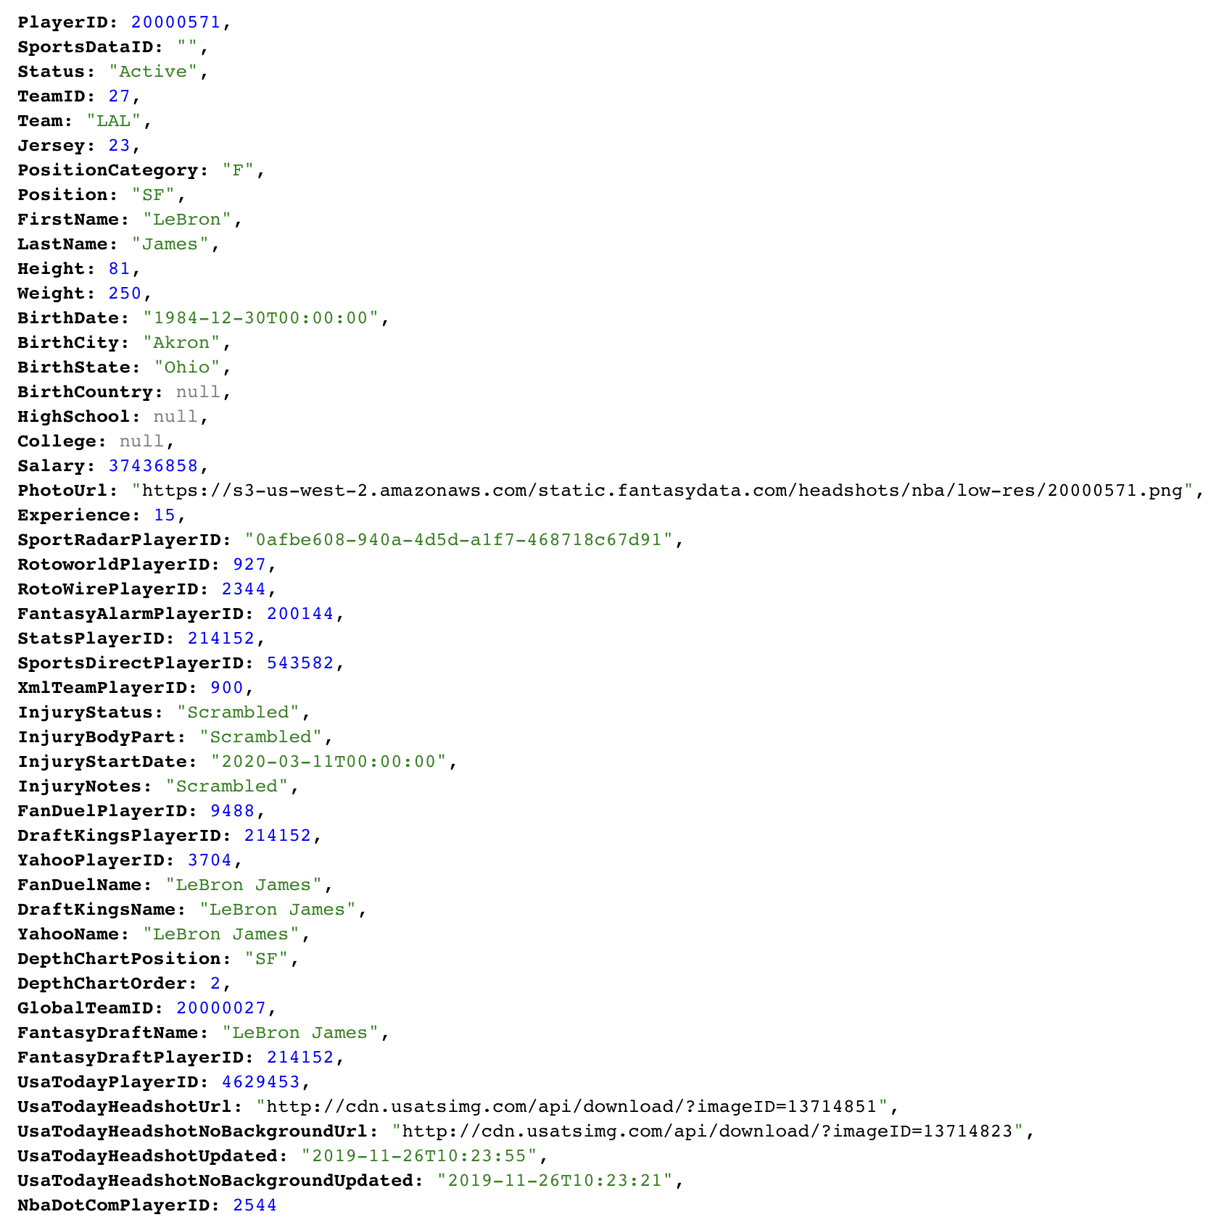
Data Gathering
'PlayerID', 'SportsDataID', 'Status', 'TeamID', 'Team', 'Jersey', 'PositionCategory', 'Position', 'FirstName', 'LastName', 'Height', 'Weight', 'BirthDate', 'BirthCity', 'BirthState', 'BirthCountry', 'HighSchool', 'College', 'Salary', 'PhotoUrl', 'Experience', 'SportRadarPlayerID', 'RotoworldPlayerID', 'RotoWirePlayerID', 'FantasyAlarmPlayerID', 'StatsPlayerID', 'SportsDirectPlayerID', 'XmlTeamPlayerID', 'InjuryStatus', 'InjuryBodyPart', 'InjuryStartDate', 'InjuryNotes', 'FanDuelPlayerID', 'DraftKingsPlayerID', 'YahooPlayerID', 'FanDuelName', 'DraftKingsName', 'YahooName', 'DepthChartPosition', 'DepthChartOrder', 'GlobalTeamID', 'FantasyDraftName', 'FantasyDraftPlayerID', 'UsaTodayPlayerID', 'UsaTodayHeadshotUrl', 'UsaTodayHeadshotNoBackgroundUrl', 'UsaTodayHeadshotUpdated', 'UsaTodayHeadshotNoBackgroundUpdated', 'NbaDotComPlayerID'
Notes:
Jason

Slide 7
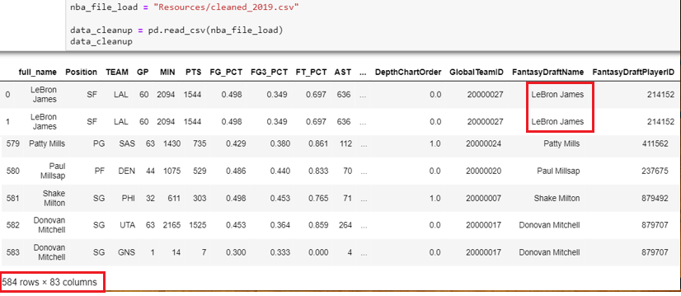
Data Cleanup
Imported CSV
Unstructured data
Notes:
Antonia

Slide 8
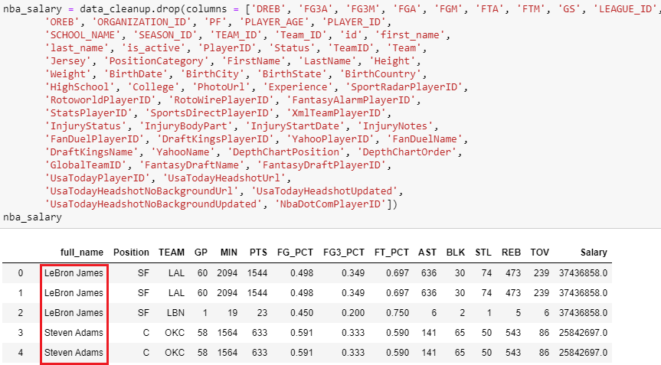
Data Cleanup
Identify columns needed
Remove duplicates
Remove null values
Sort by salary
Notes:
Antonia

Slide 9
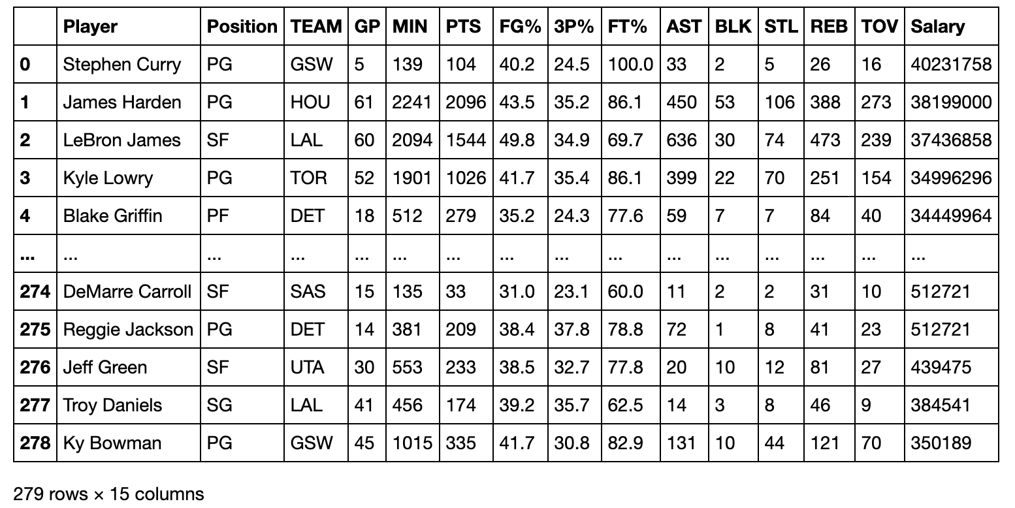
Data Analysis
Notes:
Antonia
Discuss the steps you took to analyze the data and answer each question you asked in your proposal
* Present and discuss interesting figures developed during analysis, ideally with the help of Jupyter Notebook

Slide 10
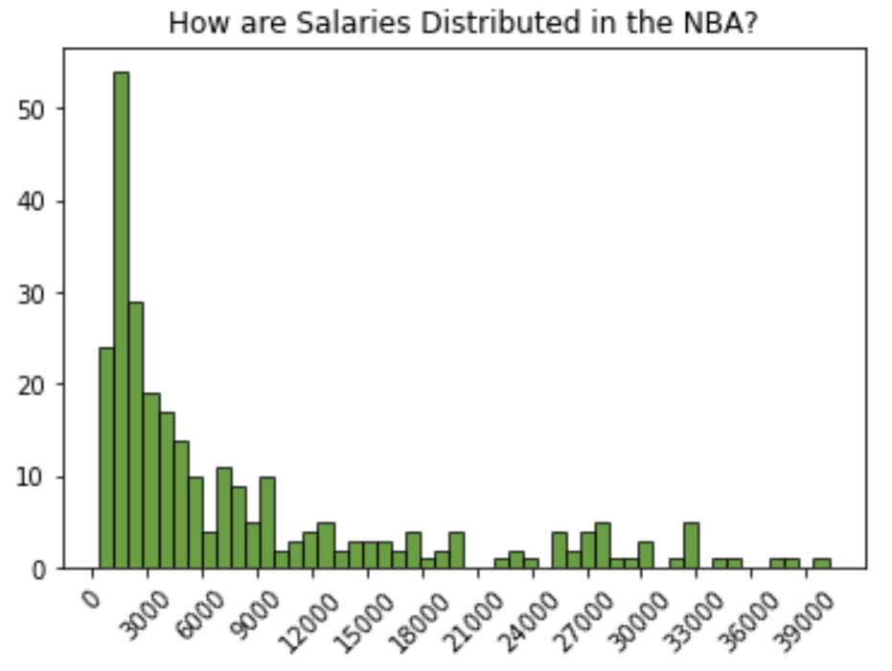
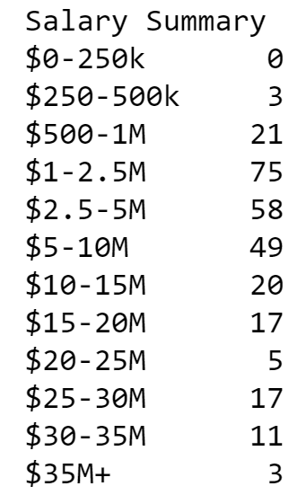
Salary Distribution
A histogram analysis of player salaries clearly shows a huge skew in the data.
Over 50% of all players make less than $3M per year while the highest paid is over $40M.
Notes:
Brent

Slide 11
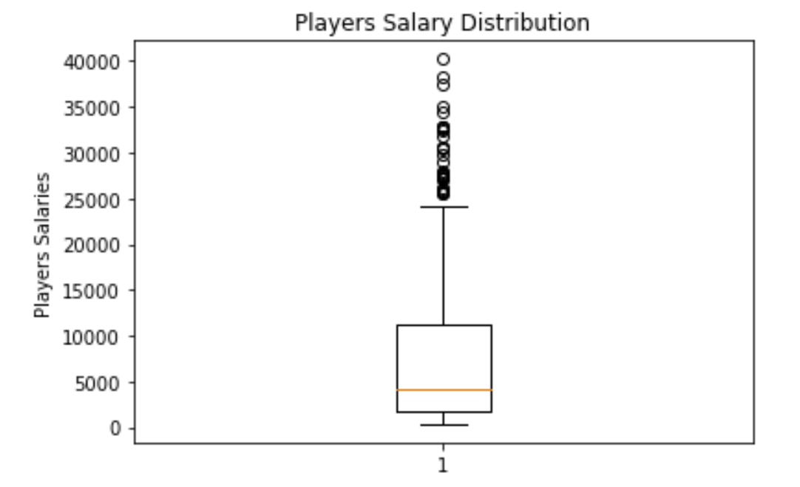
The 0.1%
The median salary is $4.1 M.
Salaries above $25.4 M are considered to be outliers.
The highest paid player is approximately 4 standard deviations above the mean.
Notes:
Brent

Slide 12
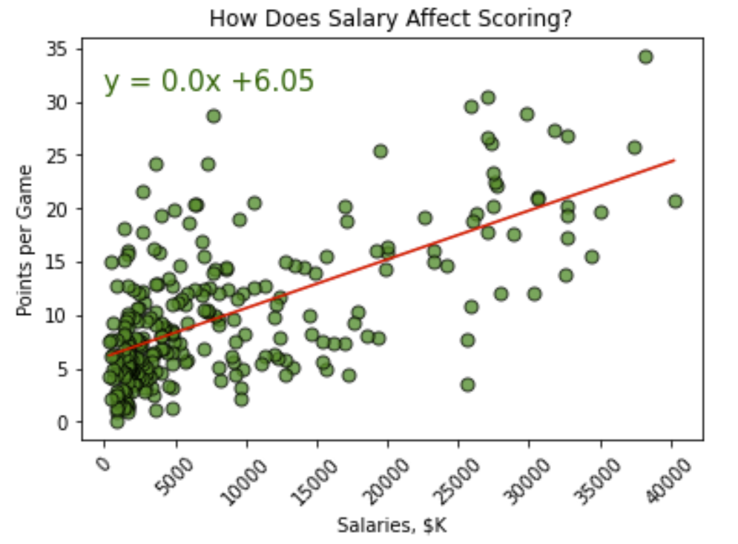
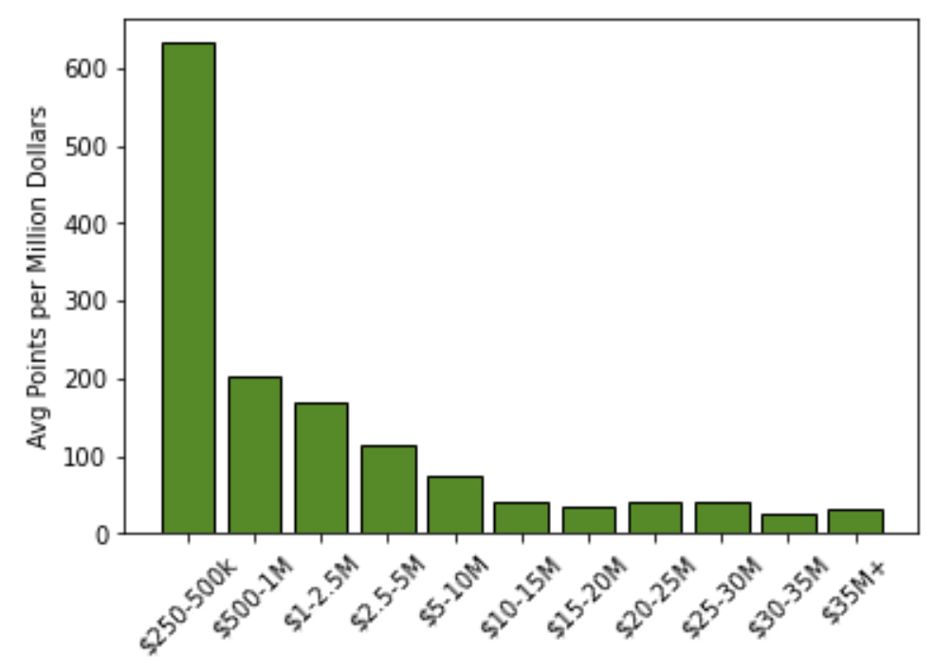

Pay for Points?
On average, teams will have to spend over $2.1 M per point.
Notes:
Brent
The chart on the left show points average points scored per million dollars spent
Very strong correlation of points per game vs salary

Slide 13
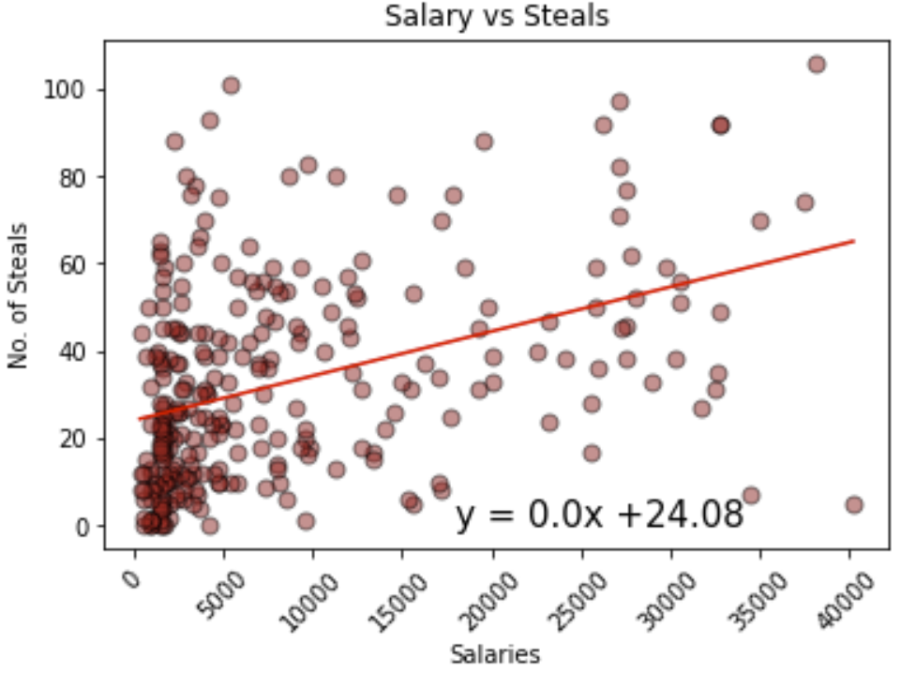
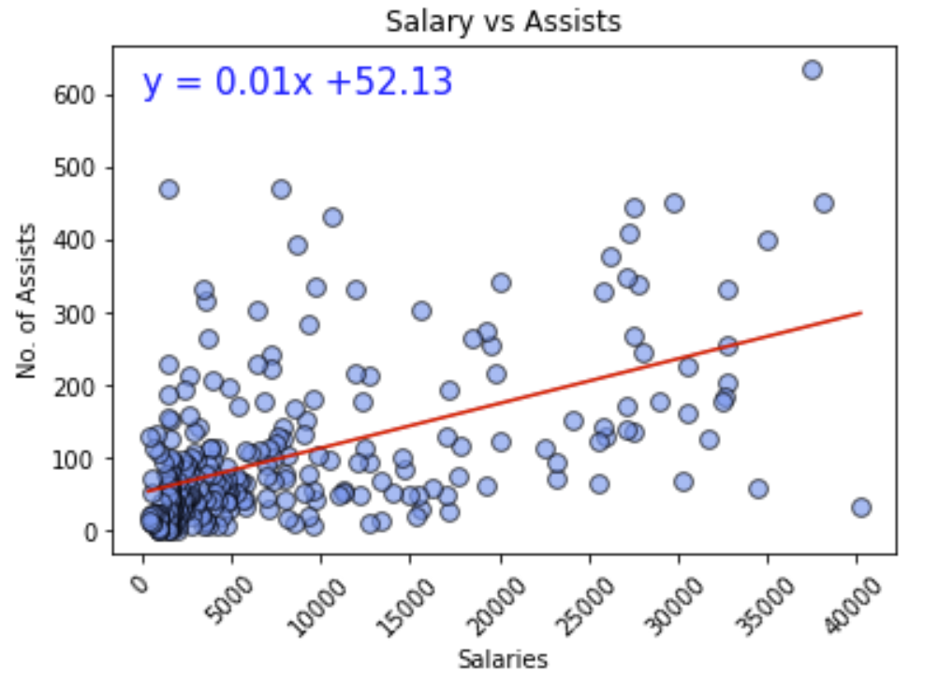
Greedy or Giving?
Notes:
Brent

Slide 14
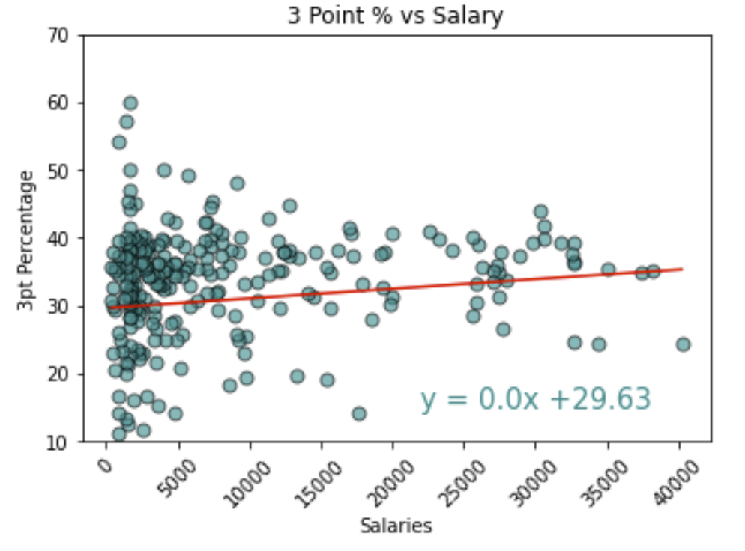
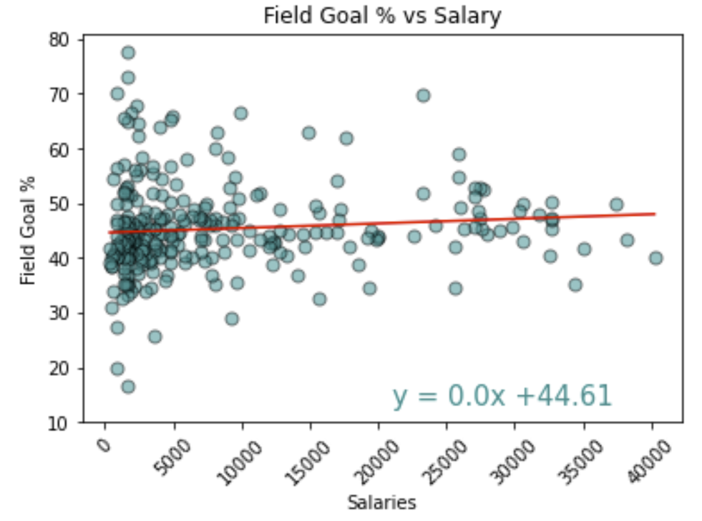
Shooting Percentages
Notes:
Brent

Slide 15
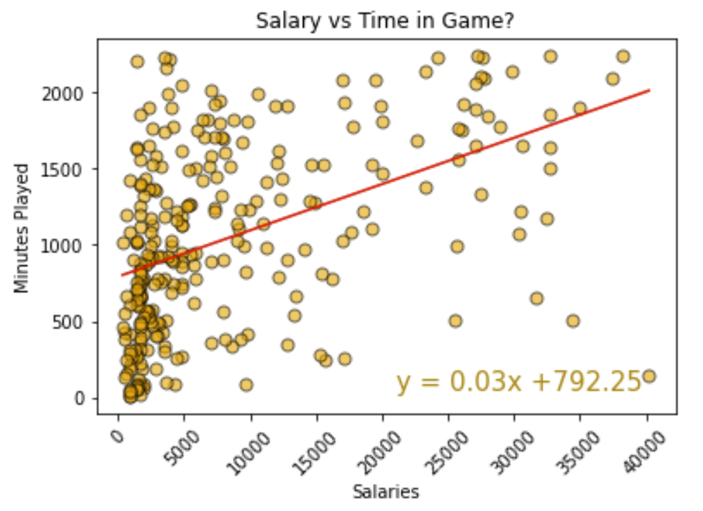
Game Time
As expected, your higher paid athletes get more play time.
Once a player is paid over $20M, they will average twice as much game time per year as someone making less than $1M.
Notes:
Brent

Slide 16
Conclusions
In general, a higher paid player will perform better, but the statistical return on the salary investment diminishes rapidly on salaries over $1M.
The ceiling effect is seen in field goal and 3-point percentages, as players seem to “max out” on these metrics across all levels of salary.
The results that we found matched several of our initial thoughts, but there were several metrics that surprised us.
Notes:
Brent

Slide 17

Post Mortem
#SixthMan
Discuss any difficulties that arose, and how you dealt with them.
API calling
Data Cleaning
Git
Discuss any additional questions that came up, but which you didn't have time to answer:
Look deeper into how team rotation (non-starter) play affects assumptions about minutes play and performance.
Geography
Team dynamics
Multi-year analysis
Notes:
Jason

Slide 18

Questions?

